Slide 1
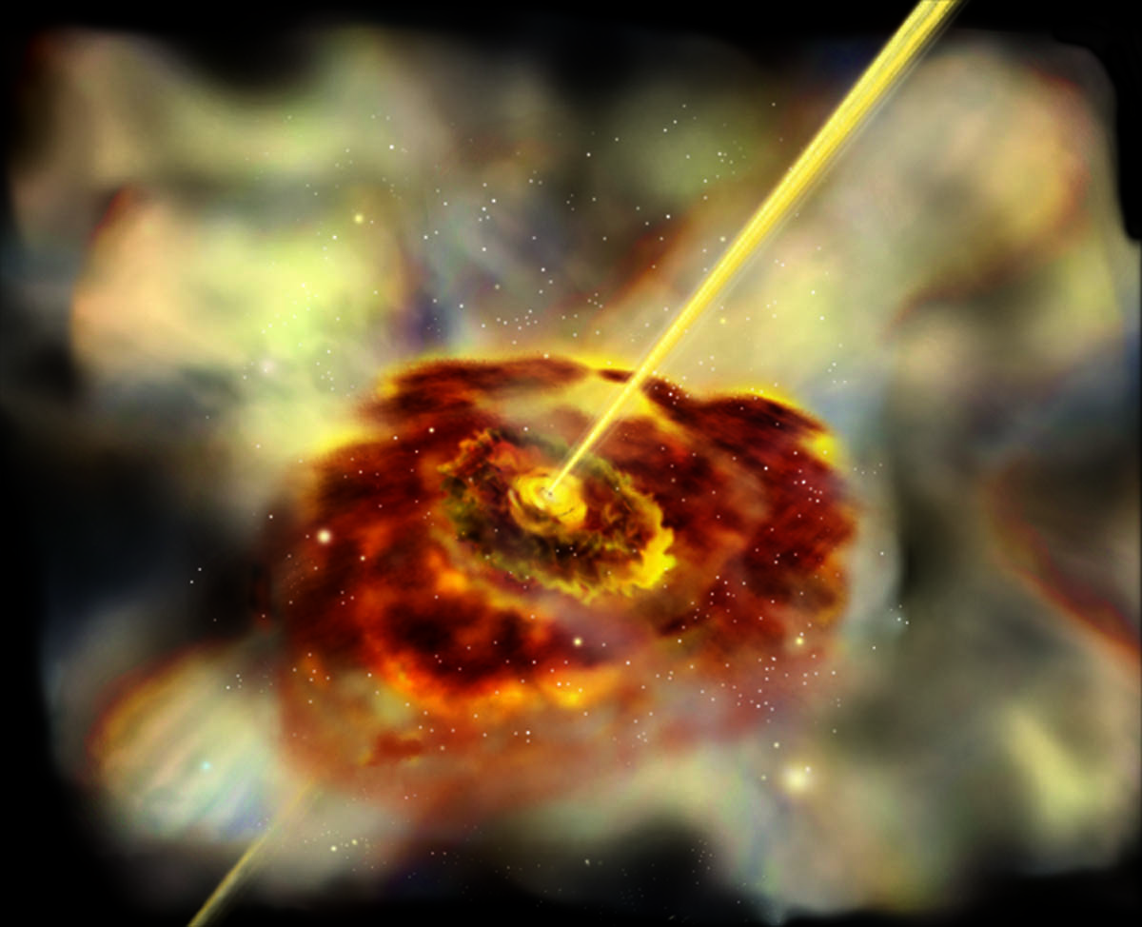
Blazing galaxies, exploding stars and monstrous black holes: High-energy visions of the Universe
Prof. Lynn Cominsky
Education and Public Outreach
Sonoma State University

Slide 2
E/PO Group Satellite Missions
XMM-Newton – launched 12/10/1999
  Focusing soft x-ray telescope
Swift – launched 11/20/2004
  Gamma-ray burst explorer
Fermi (aka GLAST) – launched 6/11/2008
  High energy gamma-ray sky survey +GRBs
NuSTAR – launched 6/13/2012
  Focusing hard x-ray telescope

Slide 3
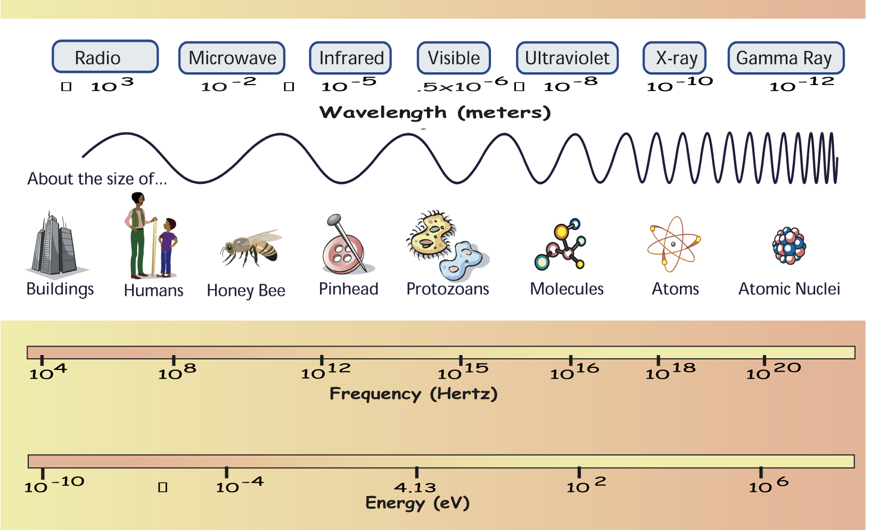
What we observe
NuSTAR 10-79 keV
Fermi 10 keV – 300 GeV
XMM 1-10 keV
Swift – UVOT, XRT and BAT

Slide 4

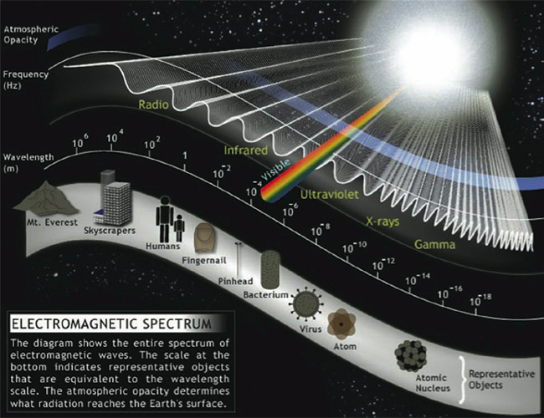

Exploring the Space Environment with
The second most energetic band of the EM spectrum
X Rays
Wavelengths about the size of atoms
Photon Energies range from around 1000 to 100,000 times that of visible light
Emitted by objects at temperatures of millions of degrees. Including supernova remnants and disks of gas orbiting black holes

Slide 5

NuSTAR:
NASA’s newest “Eyes on the Skies”
http://www.nustar.caltech.e
du
Notes:
-

Slide 6
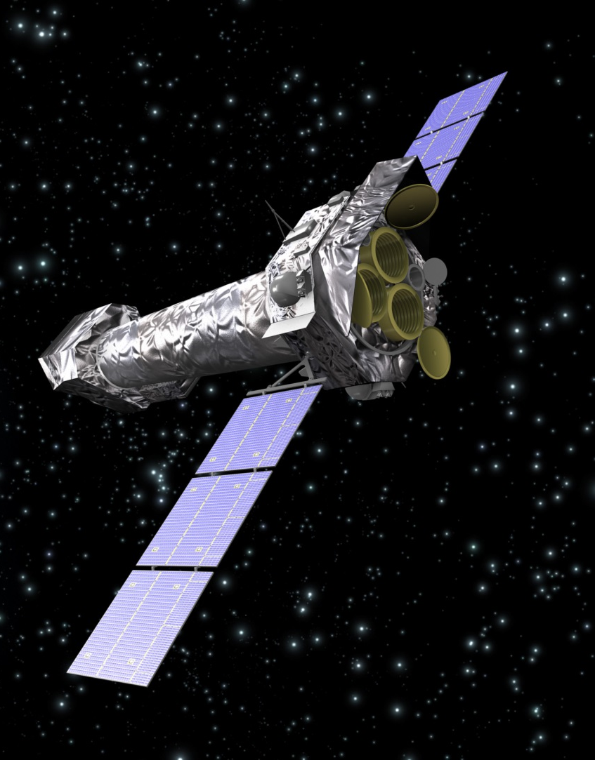
XMM-Newton
Focuses lower energy X-rays
Similar energy range to Chandra

Slide 7
Exploring the Space Environment with
The most energetic band of the EM spectrum
Gamma Rays
Wavelengths about the size of atomic nuclei
Energies more than a million times that of visible light
Only the most energetic events in the universe, like black holes and pulsars, can produce gamma rays by accelerating charges particles.

Slide 8
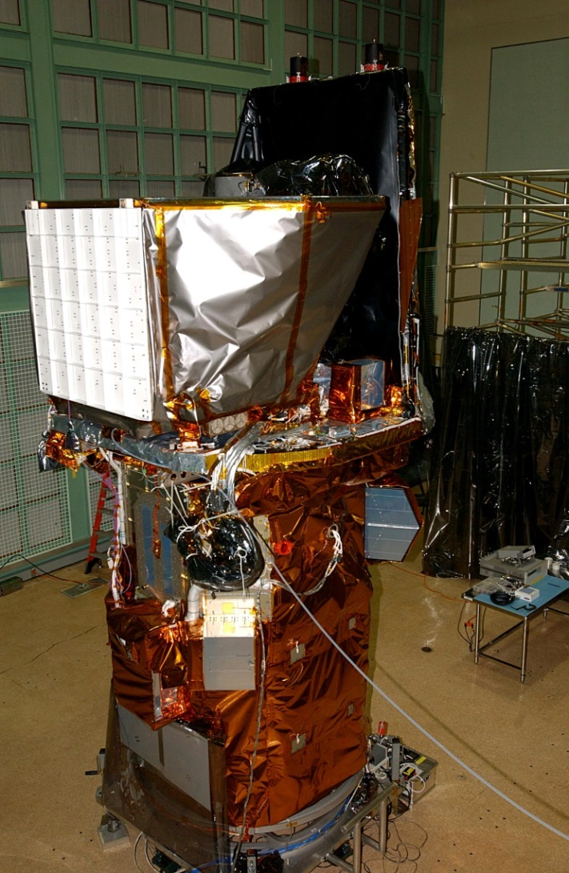
Swift GRB Mission
Burst Alert Telescope (BAT)
Ultraviolet/Optical Telescope (UVOT)
X-ray Telescope (XRT)
Studies Gamma-Ray Bursts with a swift response – usually within ~1 minute
http://swift.sonoma.edu

Slide 9
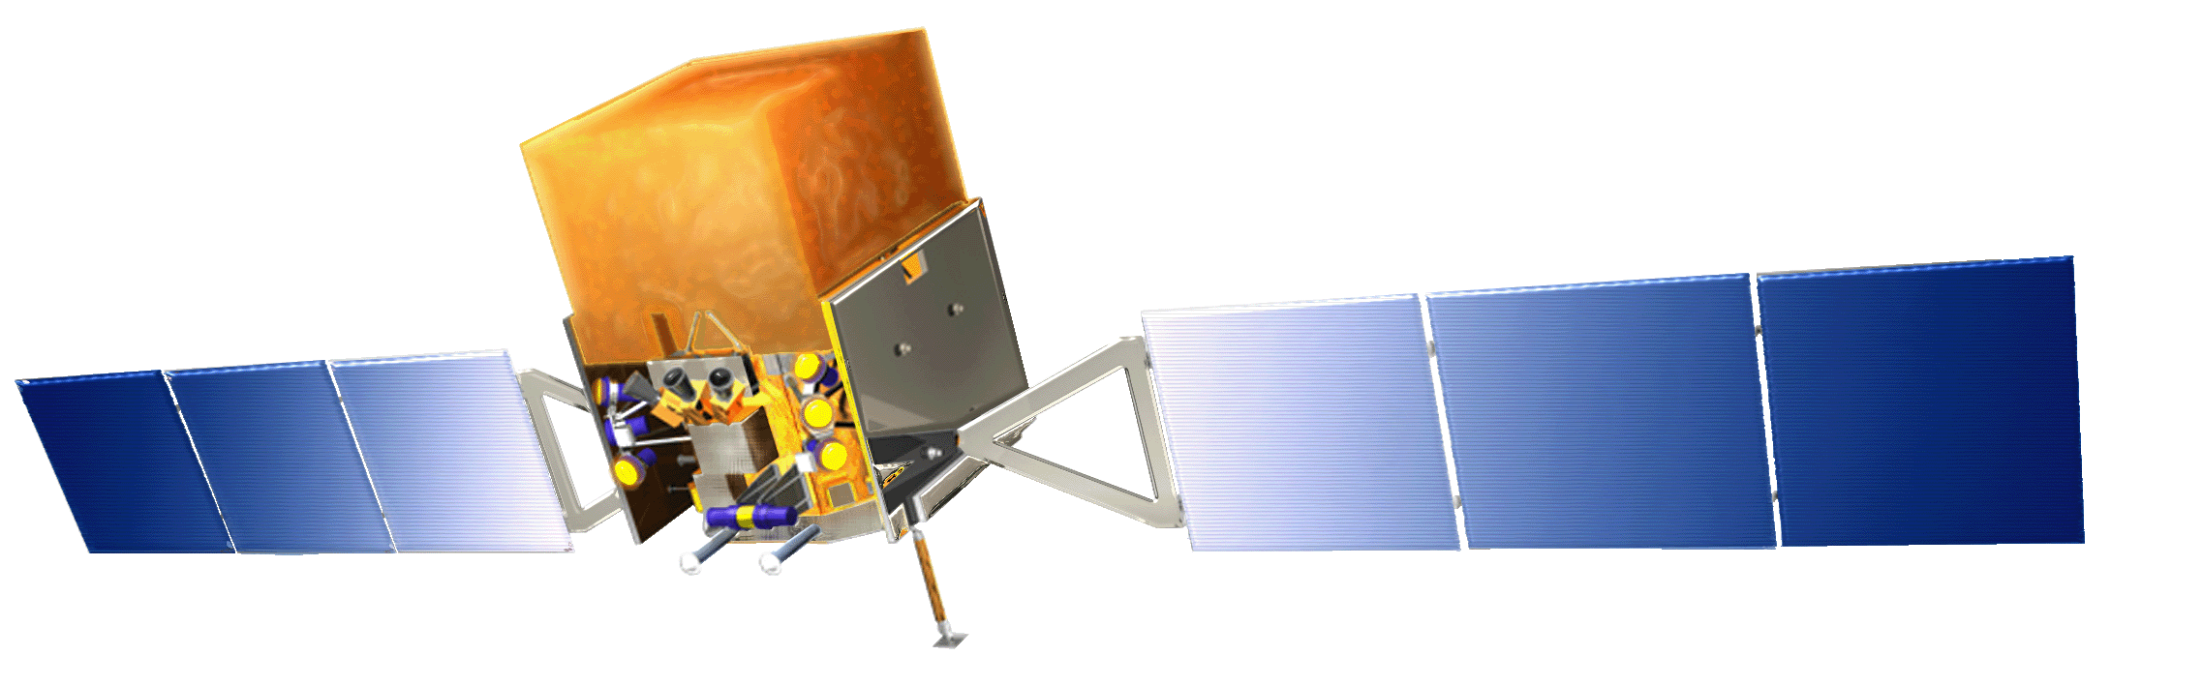
Fermi Gamma-ray Space Telescope
Launched June 11, 2008
Studies gamma rays
over a very wide energy range
http://fermi.sonoma.edu

Slide 10
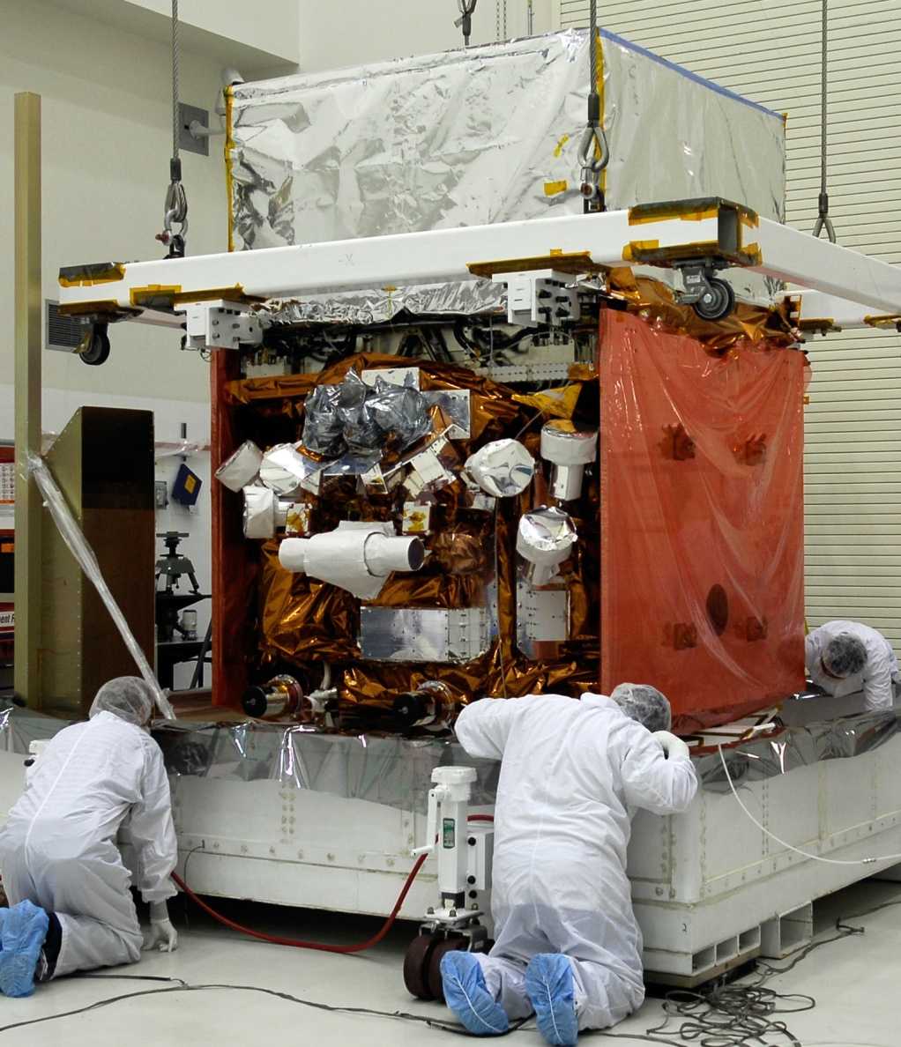
Fermi before launch
Large Area Telescope
Gamma-ray
Burst Monitor

Slide 11
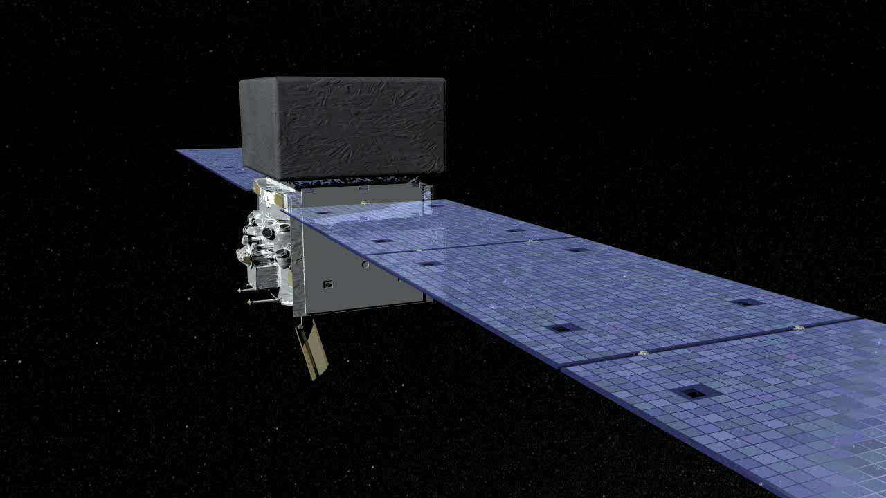
How Fermi images gamma rays

Slide 12
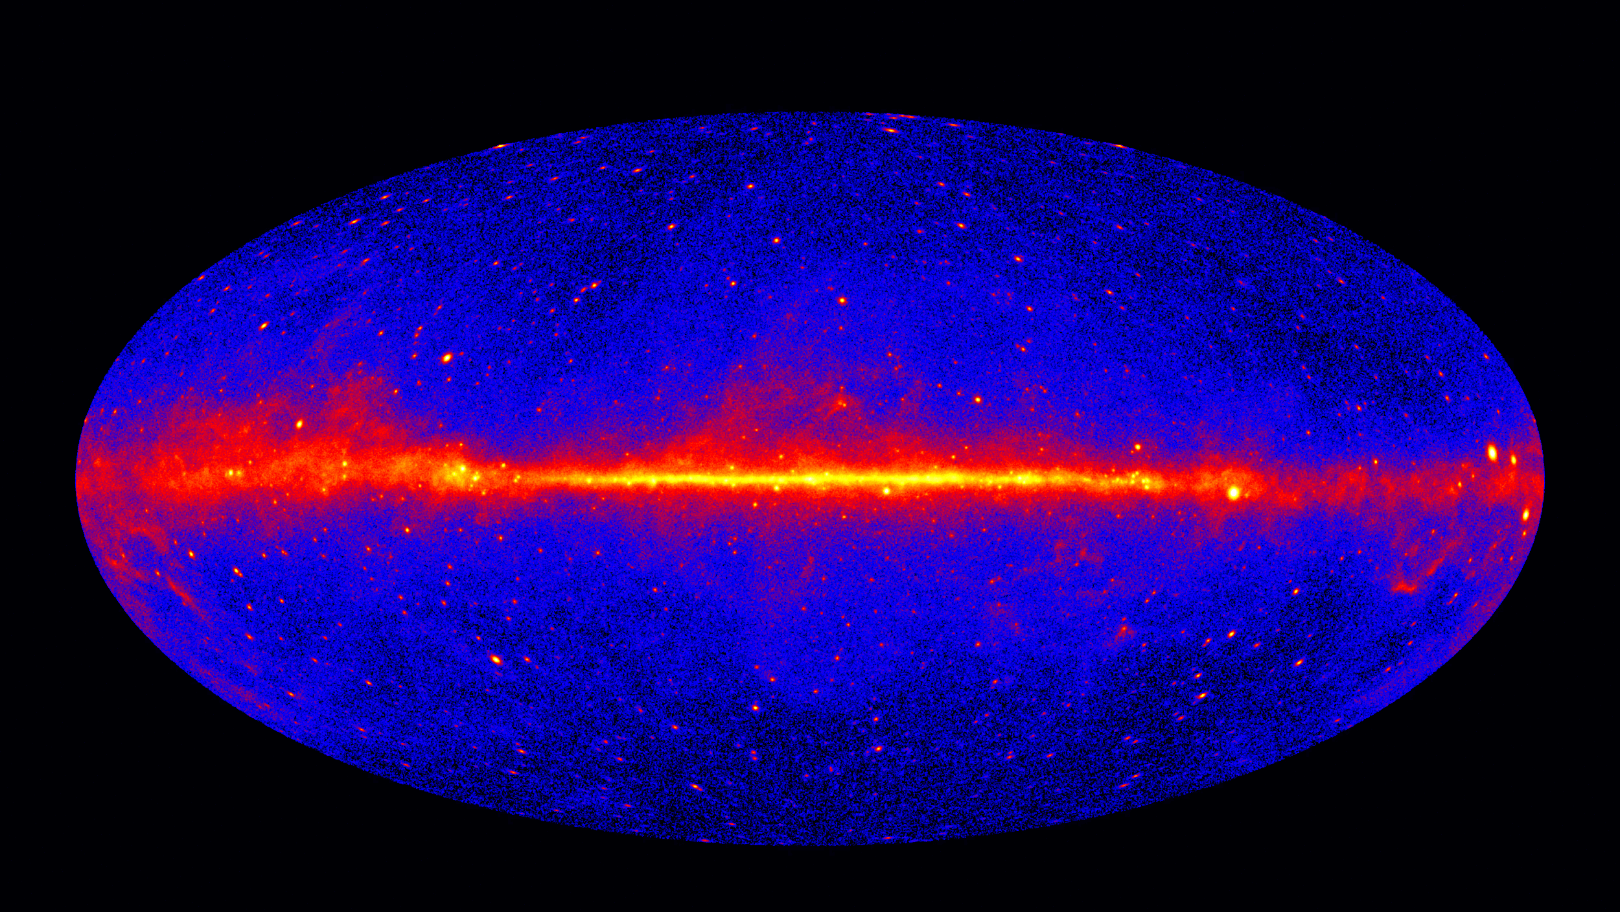
The gamma-ray sky

Slide 13
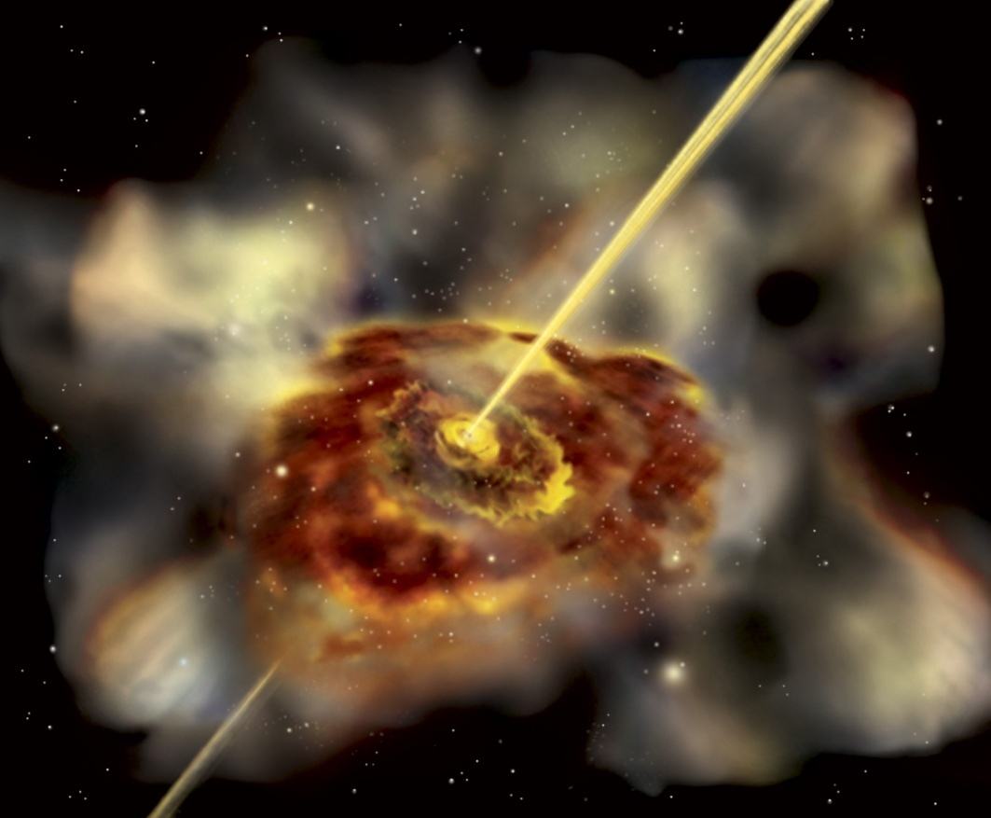
Studying Active Galaxies
Active Galaxies emit both X-rays and gamma rays
Galaxies that point their jets at us are called “blazars”
How do the black holes send out jets?
Art by Aurore Simonnet

Slide 14
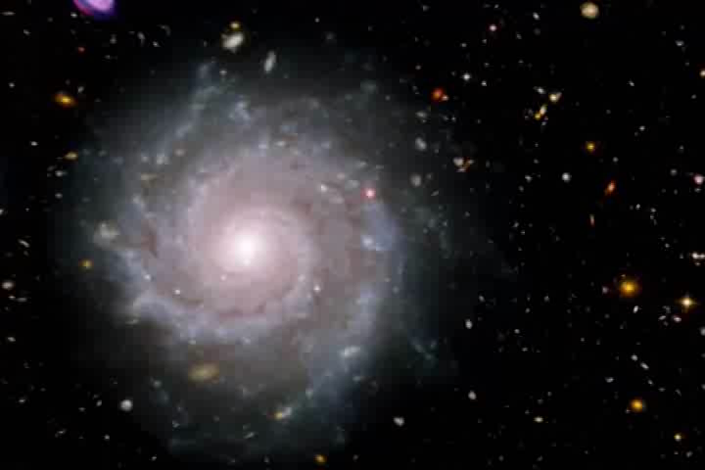
Blazing galaxies with monstrous black holes

Slide 15
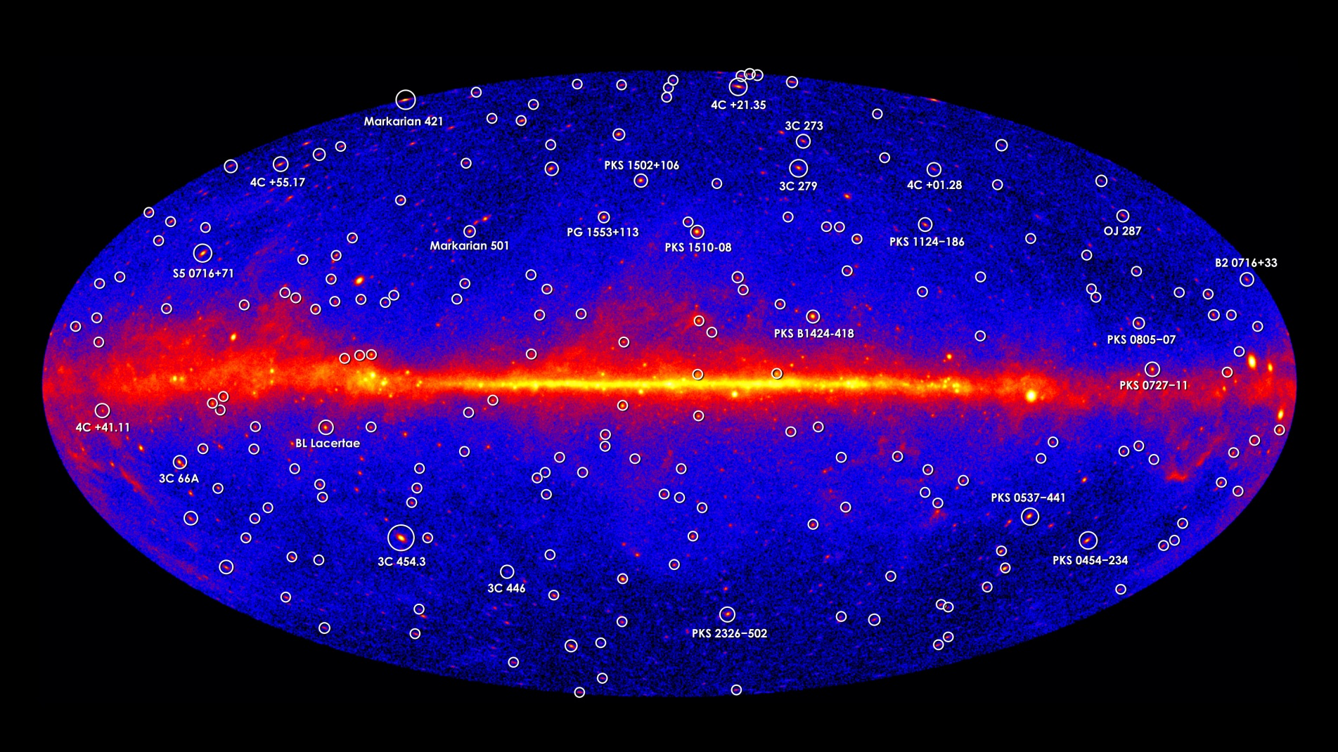
Blazars in the gamma-ray sky

Slide 16
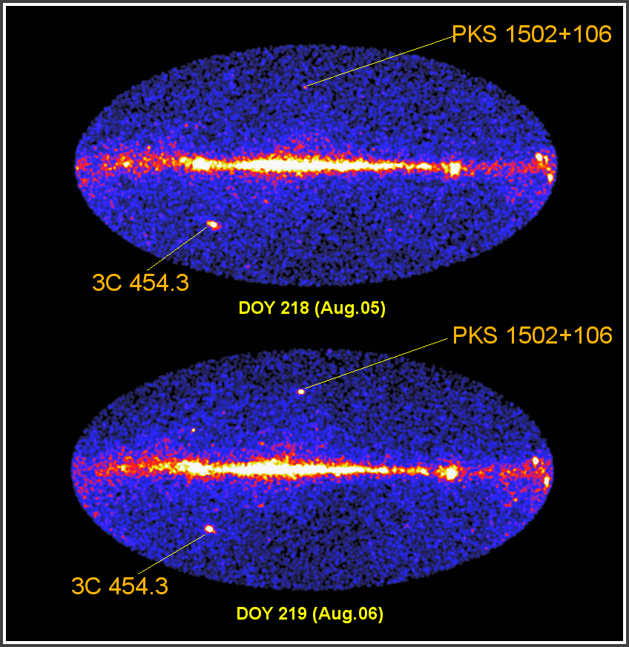
Monitoring Flares from “Blazars”
Fermi scans the entire sky every 3 hours
So blazar flares can be seen on relatively short time scales
Coordinated campaigns with many ground-based telescopes are providing information about how the flares are occurring

Slide 17
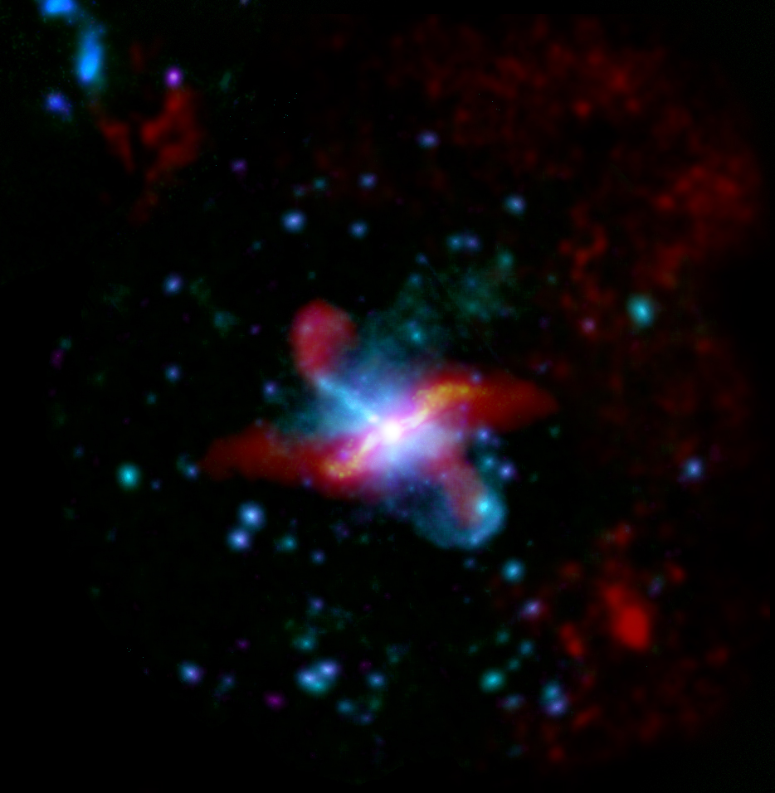
Multi-wavelength Active Galaxy
Centaurus A
Purple, blue and cyan are different X-ray bands from XMM-Newton
Yellow is infrared and radio in red from Herschel Space Observatory

Slide 18
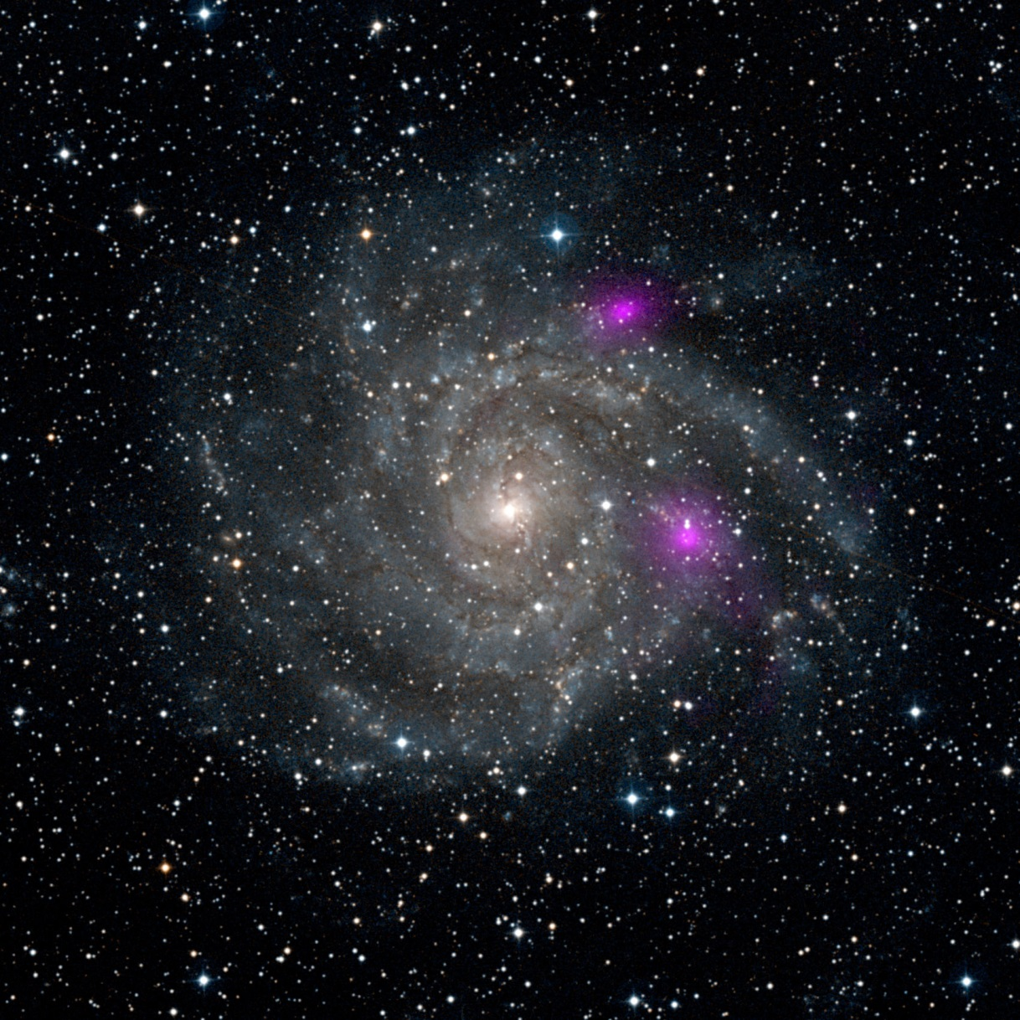
NuSTAR images two BHs in distant galaxy
Since BHs are not in center, they are probably “intermediate mass” BHs
IC 342/Caldwell 5

Slide 19
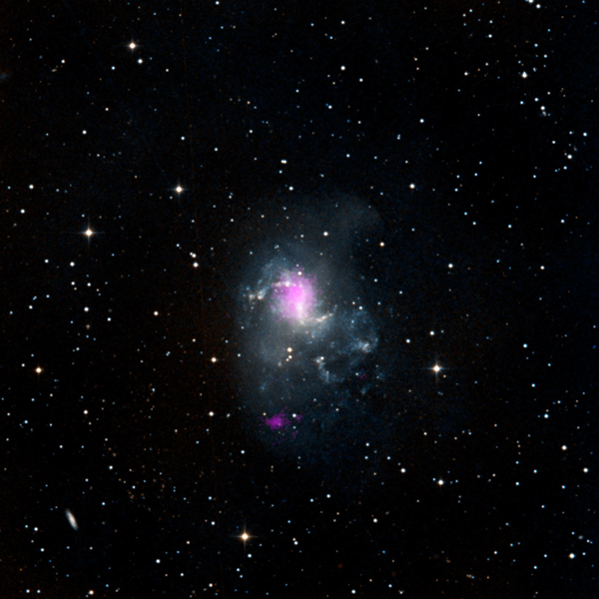
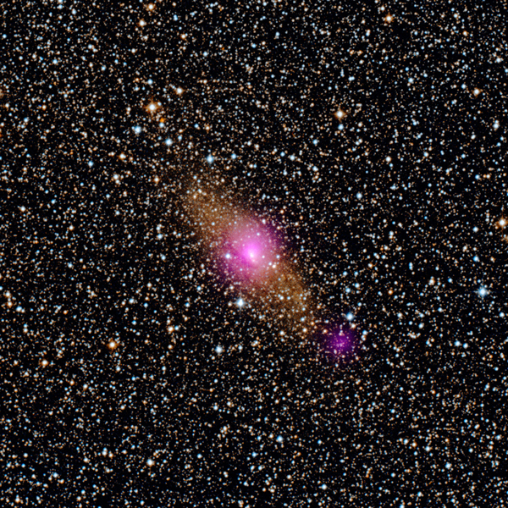
More Medium-sized BH
NGC 1313 (70 and 30 solar)
Circinus galaxy – SMBH + IMBH

Slide 20
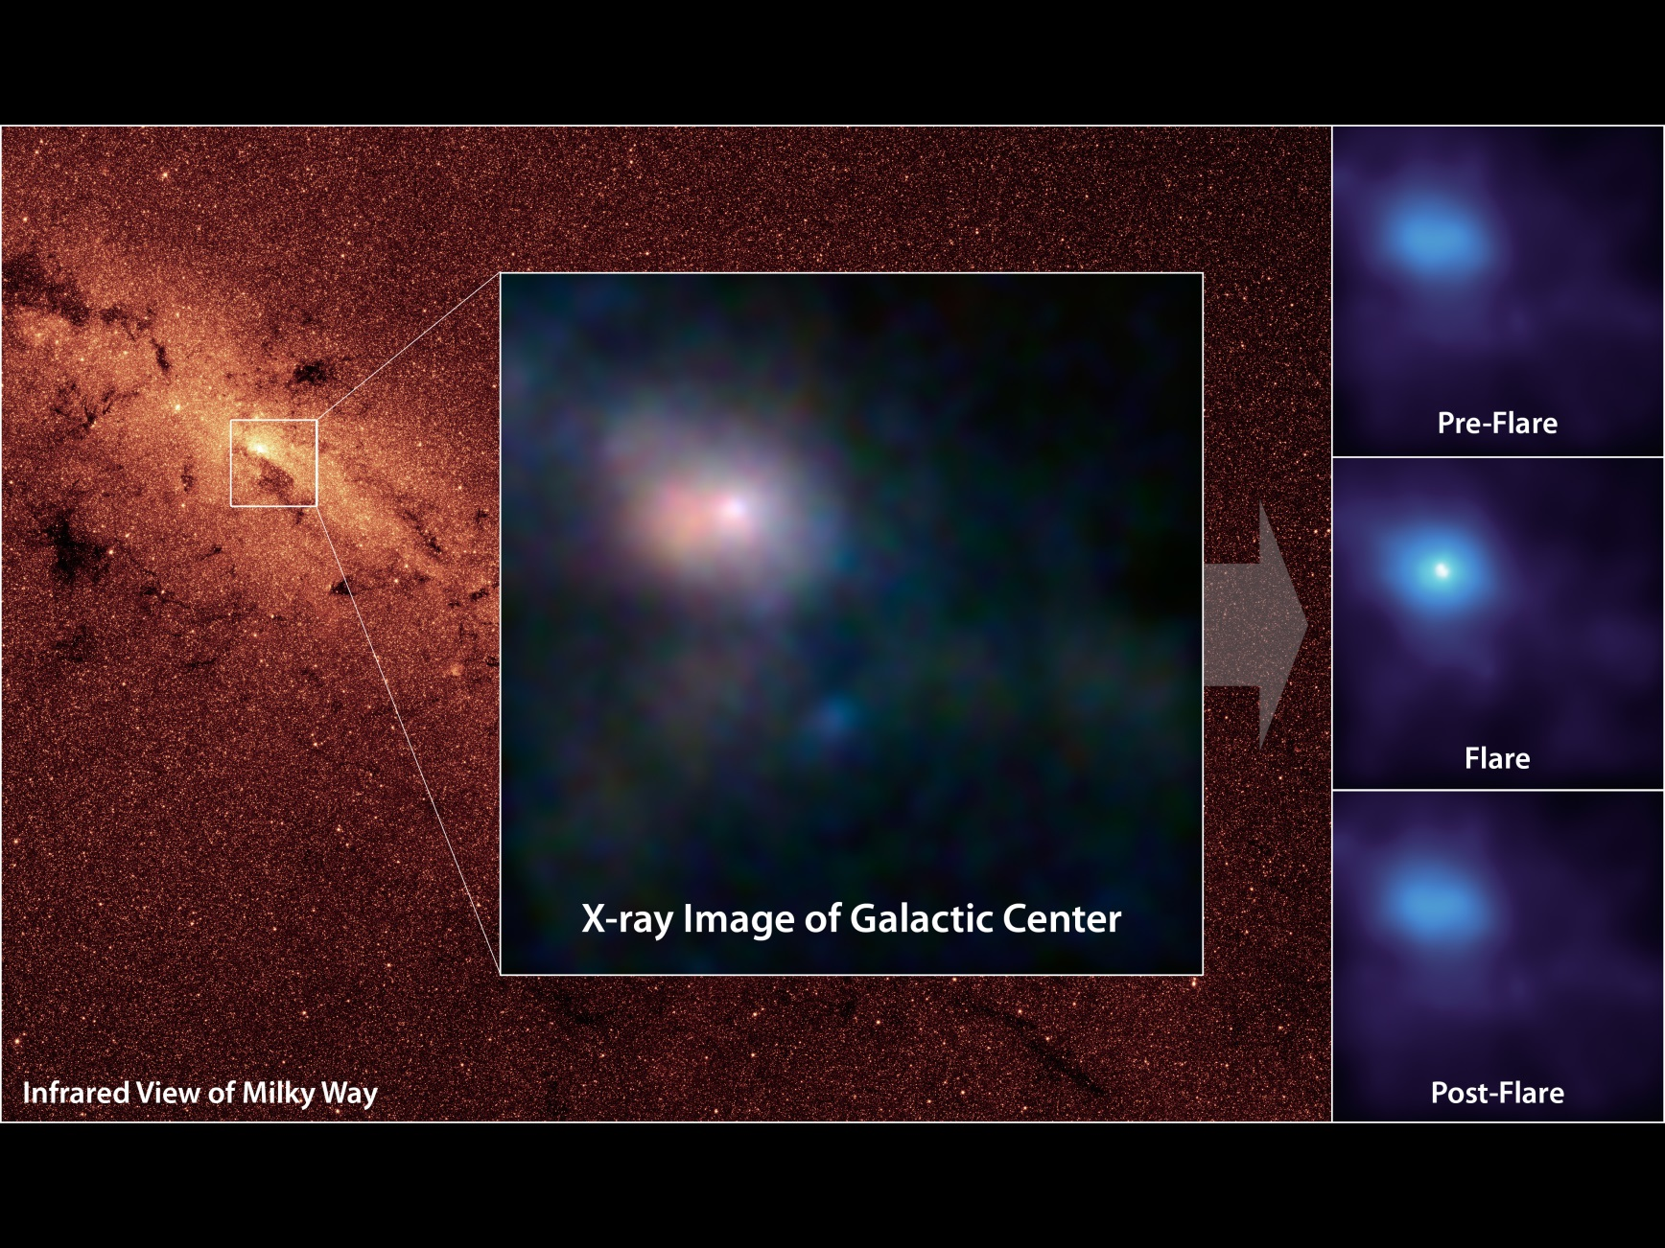
NuSTAR sees Flare from Milky Way’s Black Hole

Slide 21
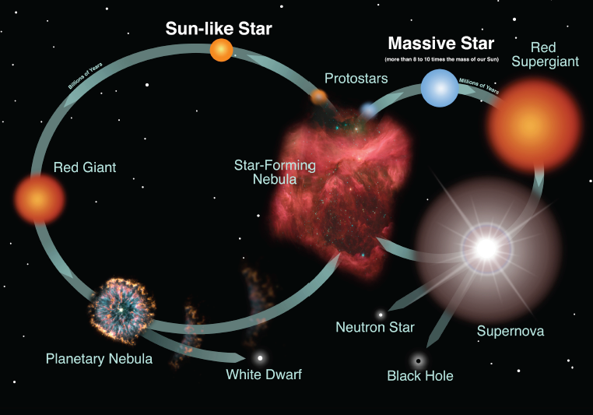
Life Cycle of Stars

Slide 22
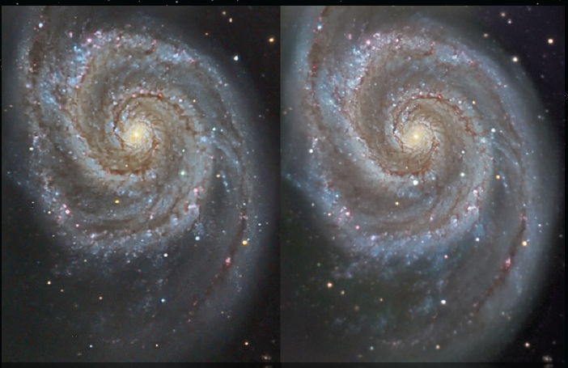
Find the Supernova
Before After
Credit: R. Jay GeBany

Slide 23
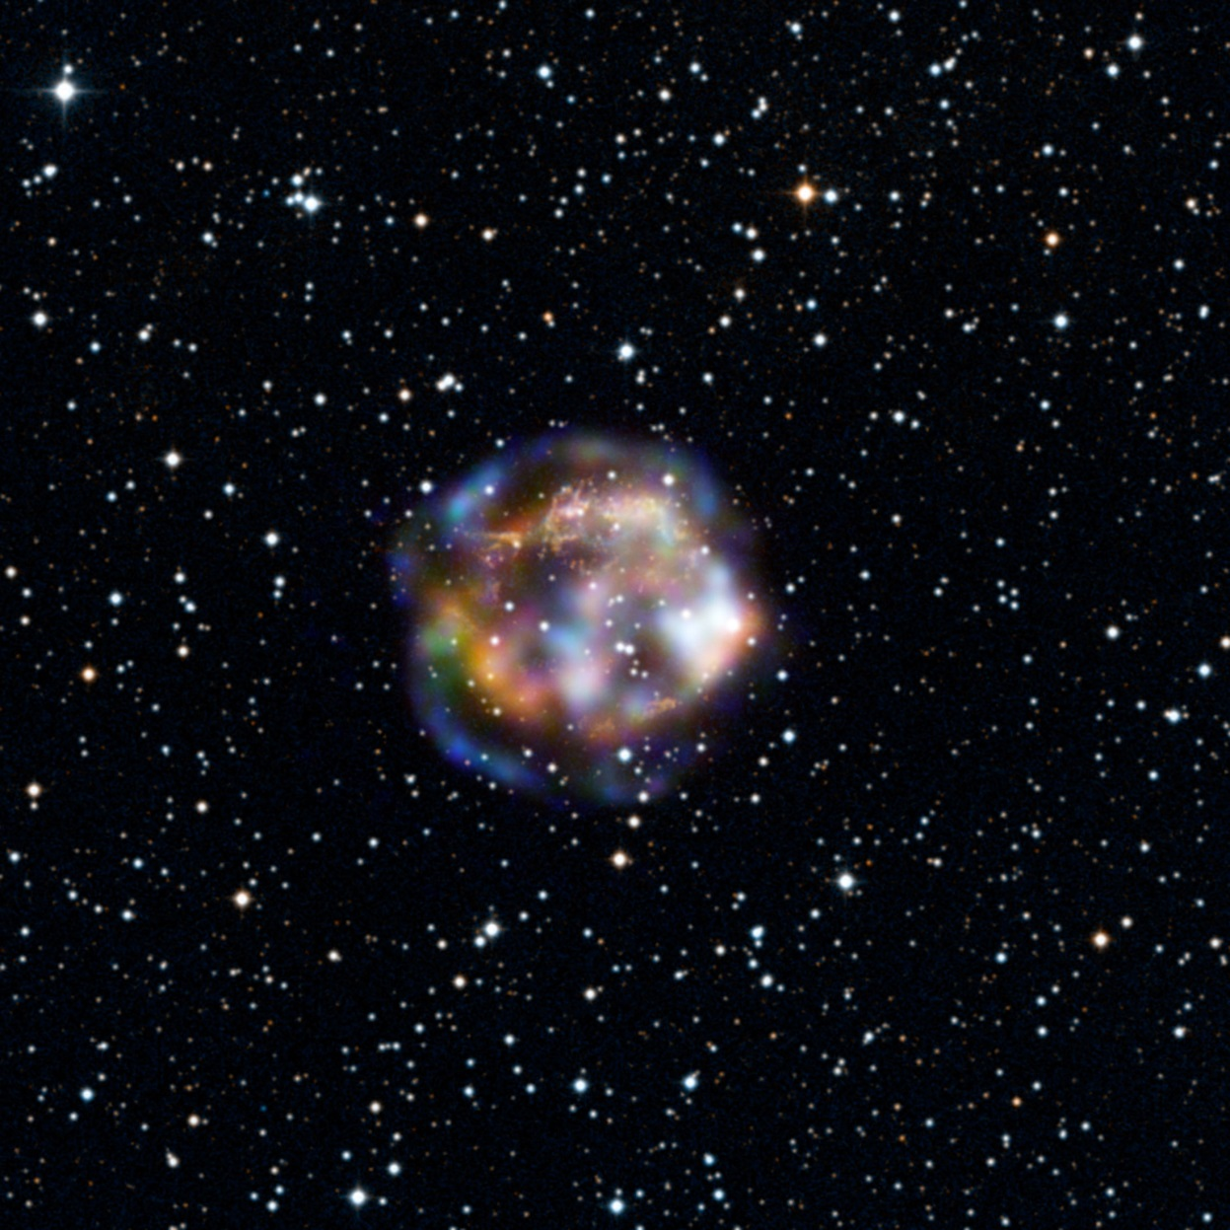
NuSTAR Cas A image
Blue shows the highest energy X-rays, not imaged before NuSTAR
Green and red show the lower energy X-rays, also seen with Chandra

Slide 24
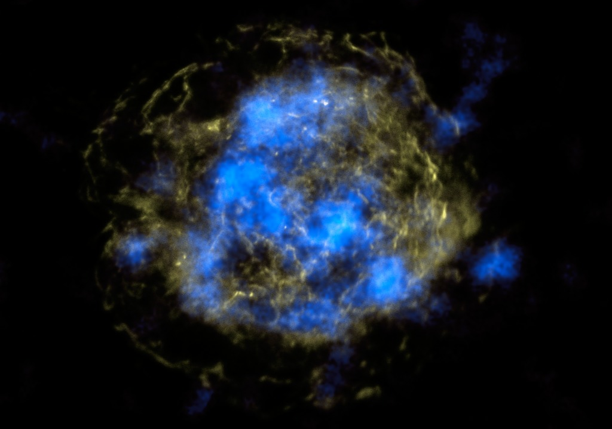
Radioactive “guts” in Cas A
NuSTAR data are blue, and show high-energy X-rays from radioactive Titanium. Yellow is non-radioactive material emitting low-energy X-rays (from Chandra).

Slide 25
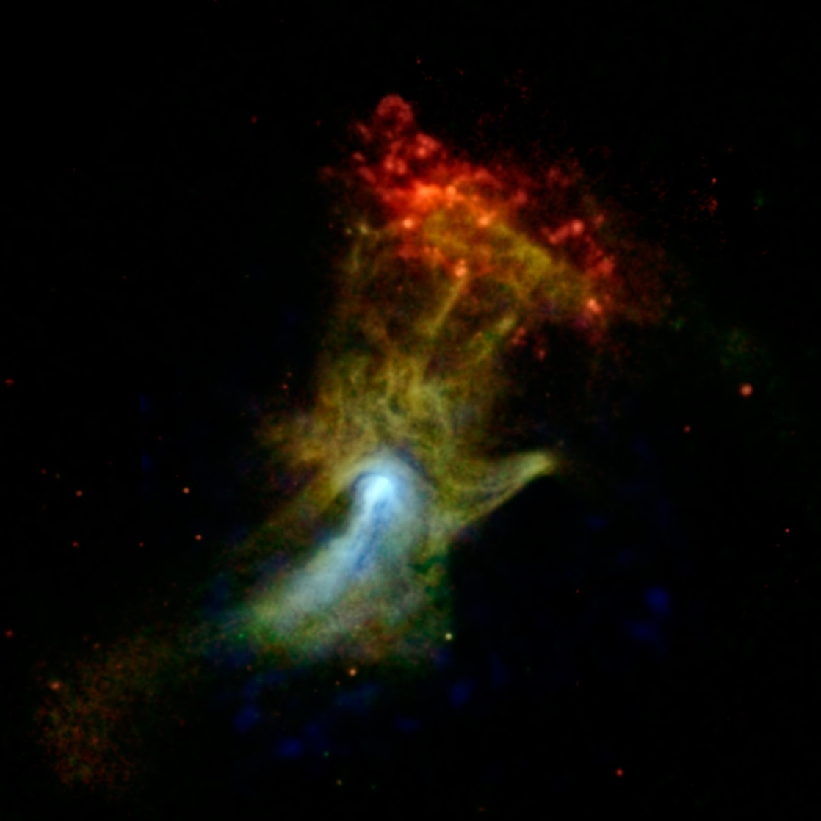
The “Hand of God”
Glowing gas blown out from a pulsar formed in a supernova explosion
High-energy X-rays seen by NuSTAR are in blue (lower-energy in green and red from Chandra)

Slide 26
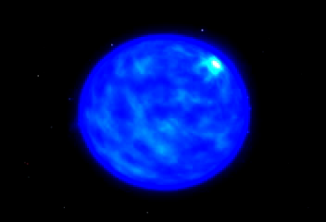
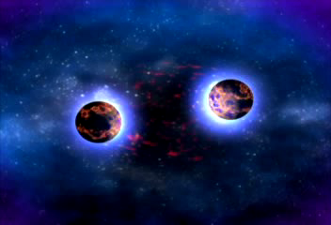
More super than a supernova?
A gamma-ray burst!
Long bursts (>2 seconds) may be from a hypernova: a super-supernova
Short bursts (<2 s) may be from merging neutron stars
GRBs are birth cries of black holes
Each GRB emits as much energy as our Sun in its entire lifetime!

Slide 27
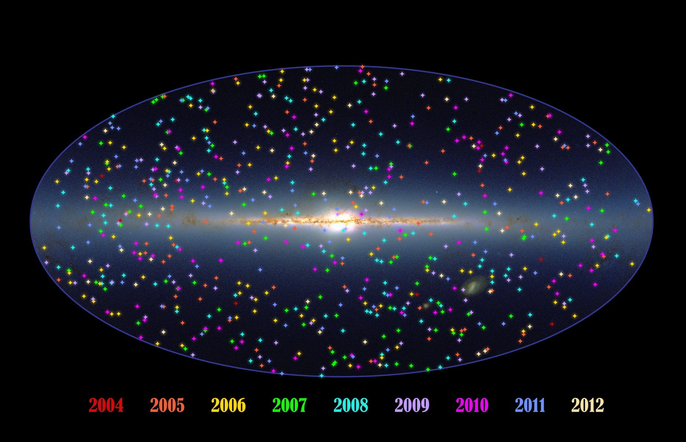
667 Swift Gamma-ray Bursts

Slide 28
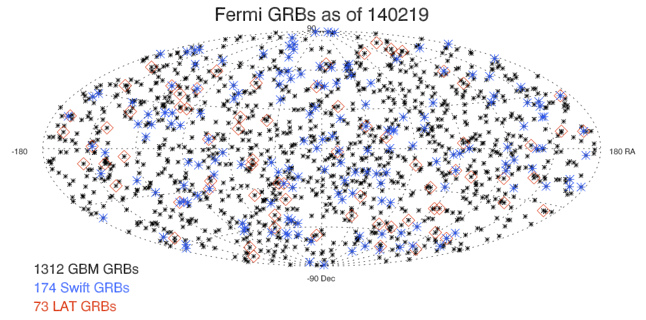
Fermi Gamma-ray Bursts
About 4-5 bursts per week
Follow bursts on http://grb.sonoma.edu

Slide 29
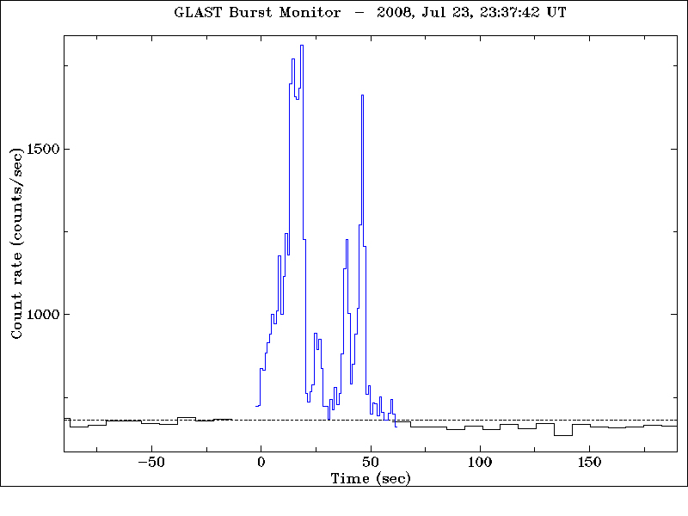
Typical strong GRB seen by GBM
1300+ GBM bursts seen to date
70+ LAT-GBM bursts seen in first 5 years

Slide 30
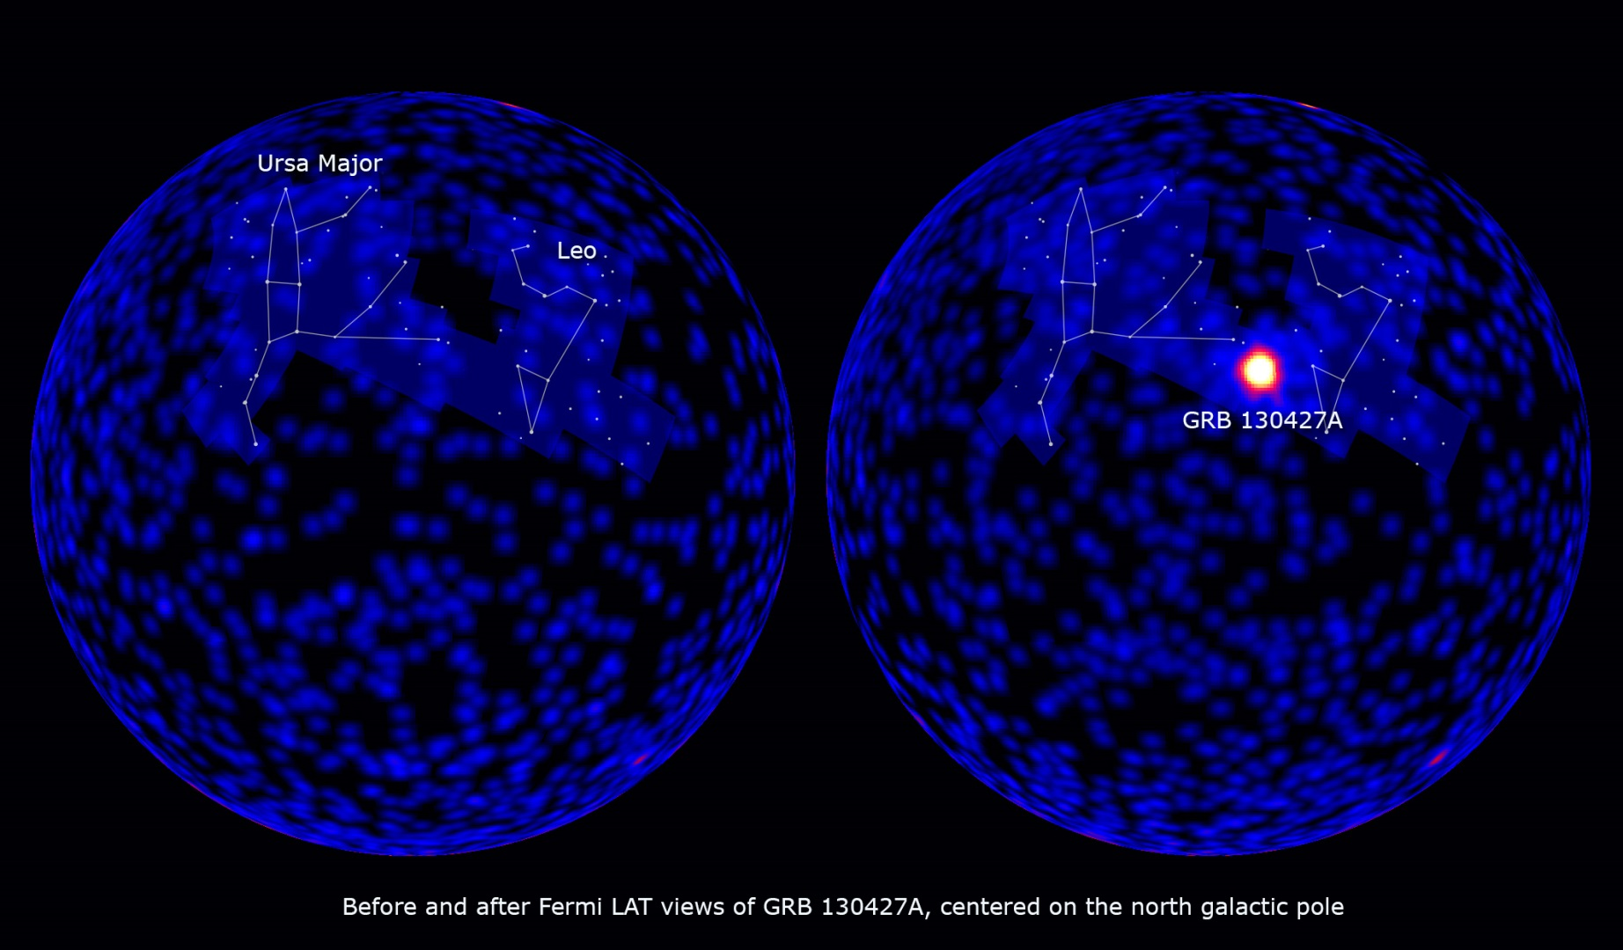
GRB130427A – a “shockingly bright” GRB

Slide 31
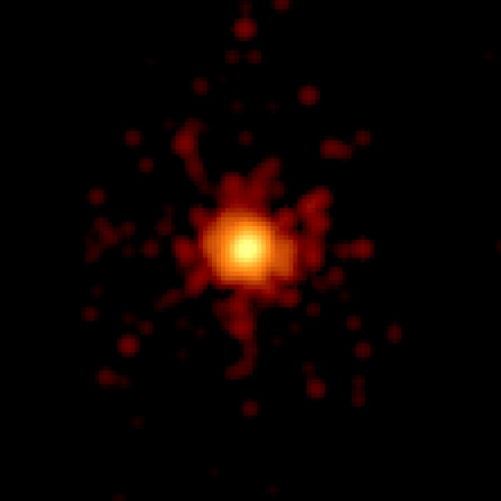
GRB 130427A
Record photon energy – 94 GeV!
Burst emission persisted for ~day
Seen by many satellites, ground-based telescopes
3.6 billion light-years away
Swift X-ray image of 0.1 seconds of data

Slide 32
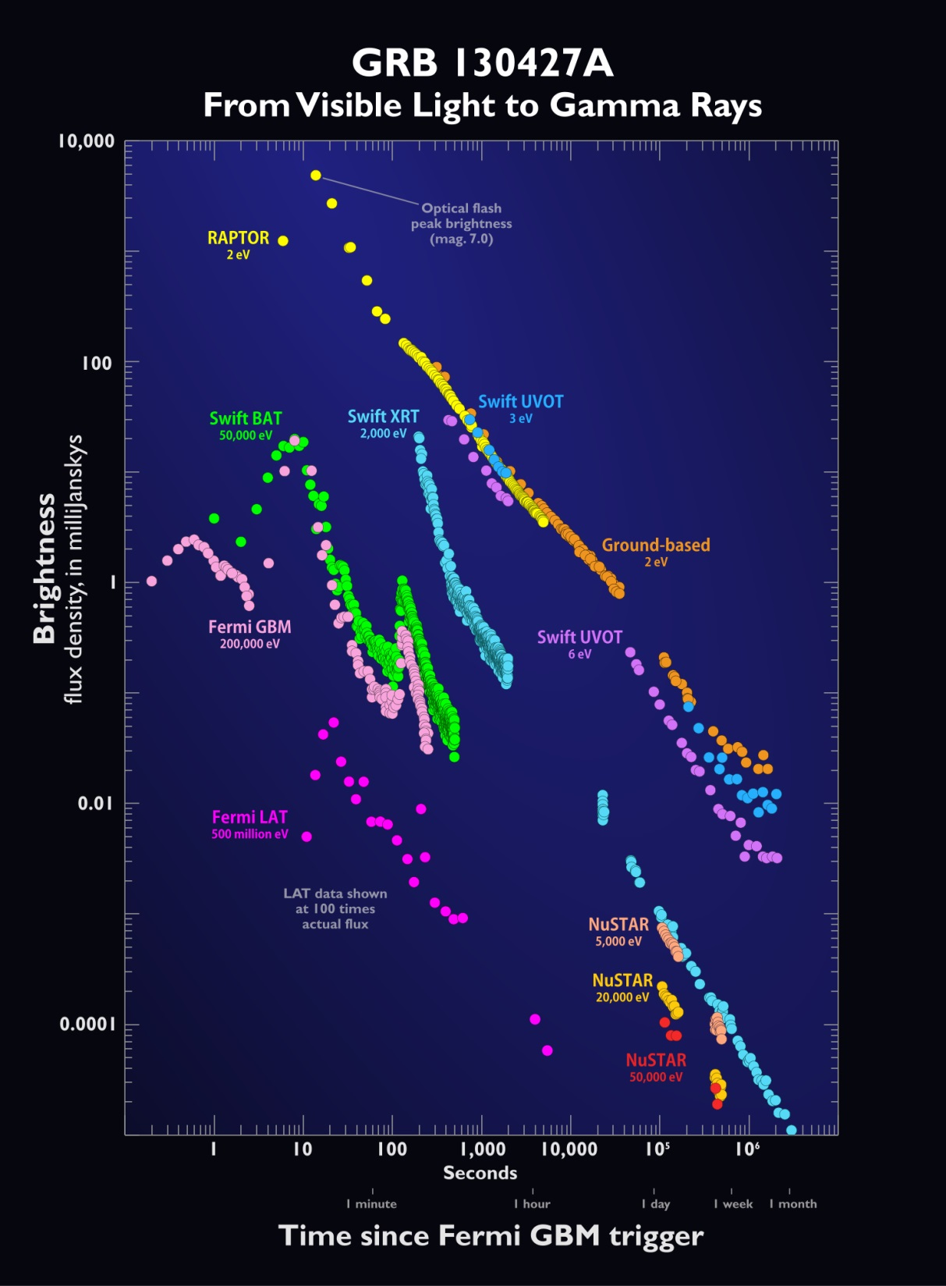
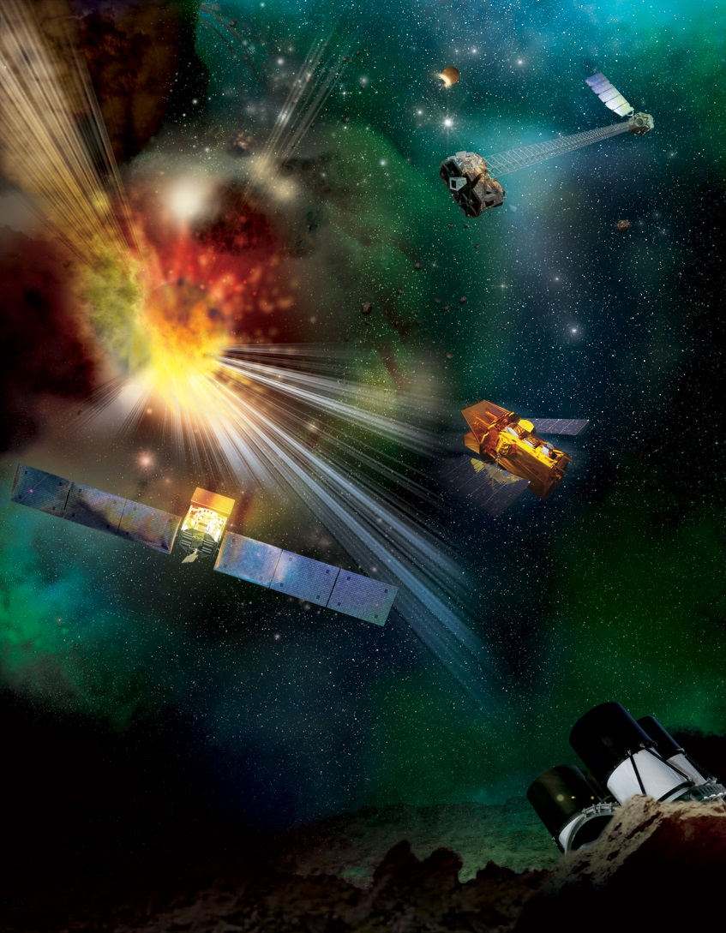
Observing from space and ground

Slide 33

Why the GRB was so bright

Slide 34
Conclusions
The Universe as seen in X- and gamma rays shows us a different view of many extreme and exotic events
It is only by putting together observations at many different energies that we can get a complete picture of our Universe

Slide 35
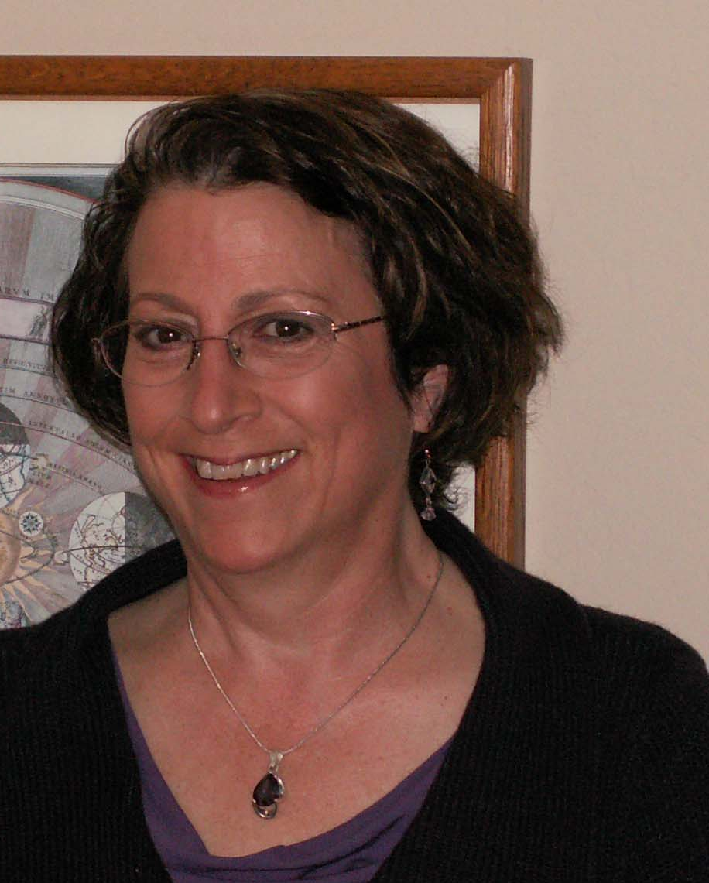
Resources
http://epo.sonoma.edu
http://swift.sonoma.edu
http://fermi.sonoma.edu
http://xmm.sonoma.edu
http://grb.sonoma.edu
http://www.nustar.caltech.edu

Slide 36
Backups follow

Slide 37
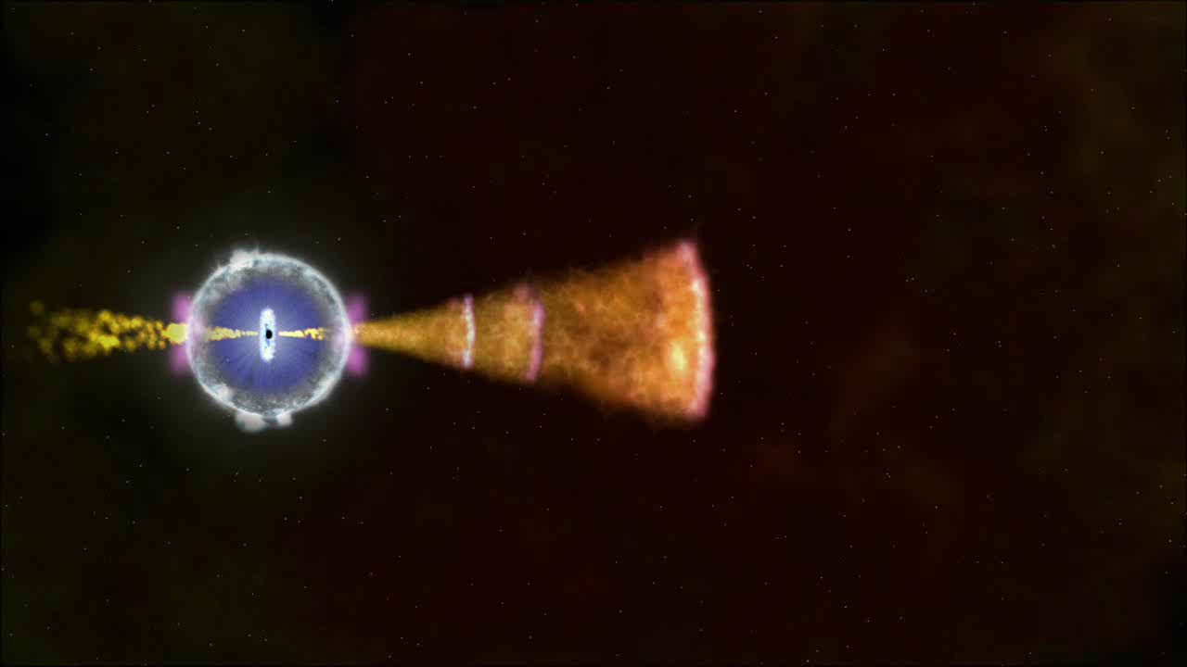
How the jets emit X and γ-rays

Slide 38
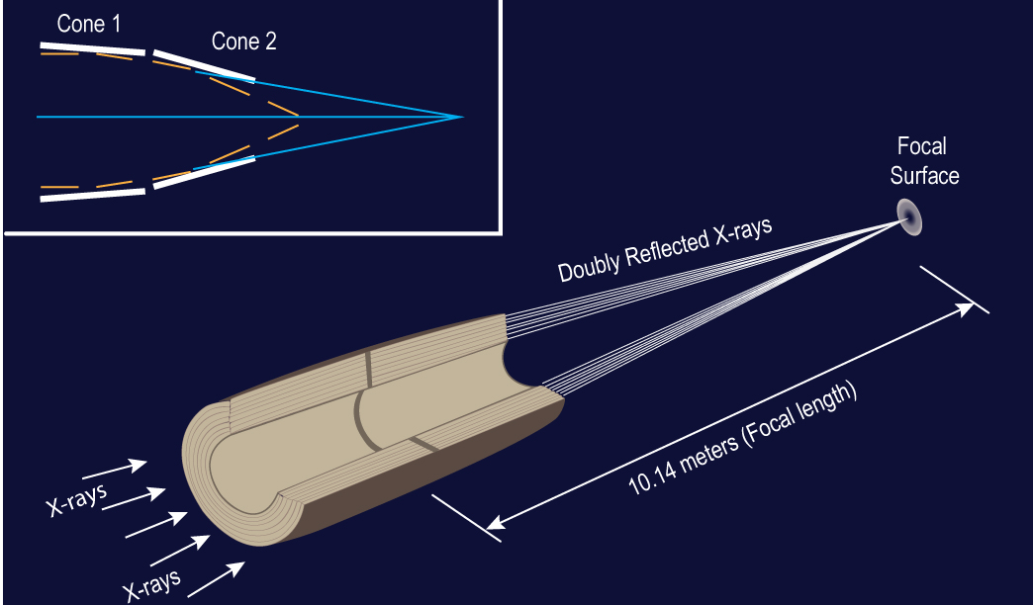
How to focus X-rays

Slide 39
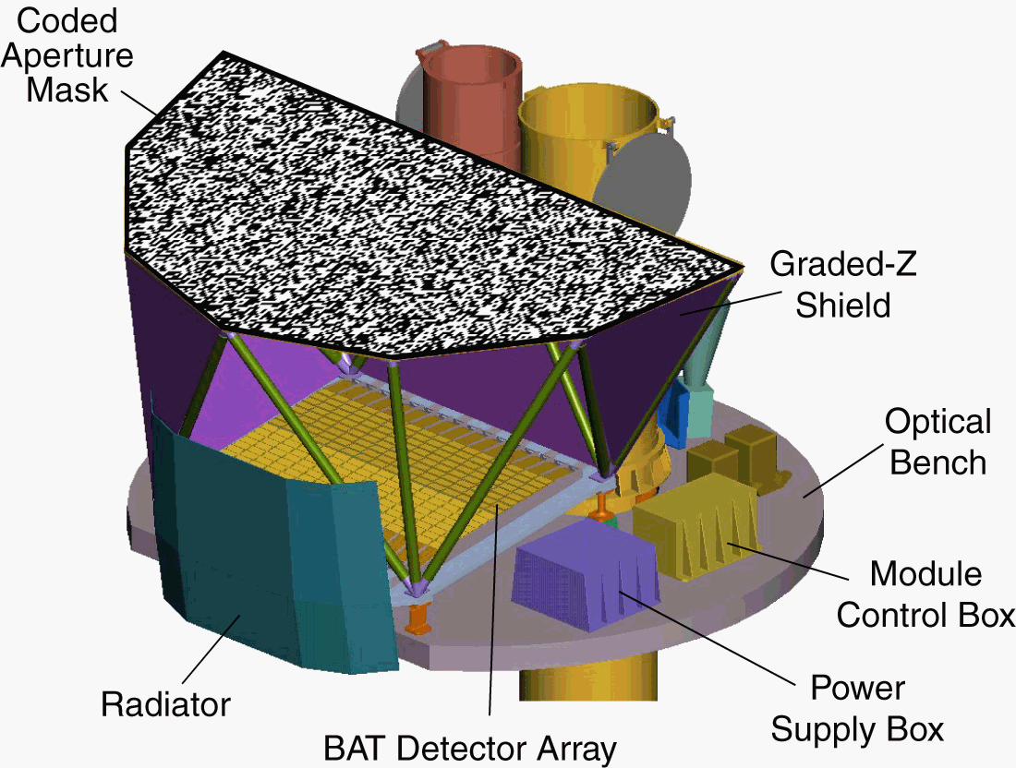
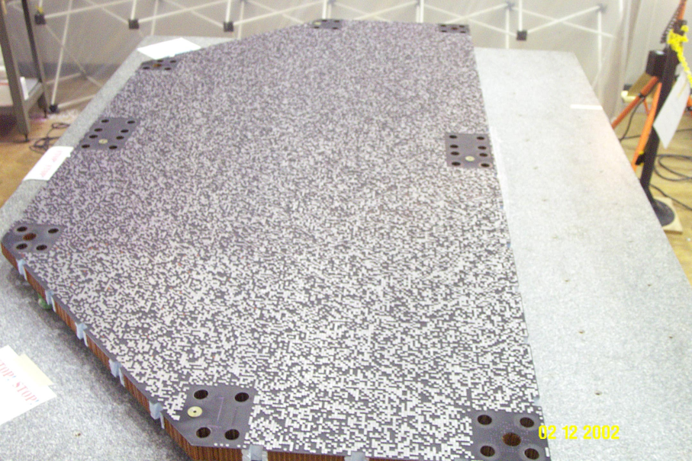
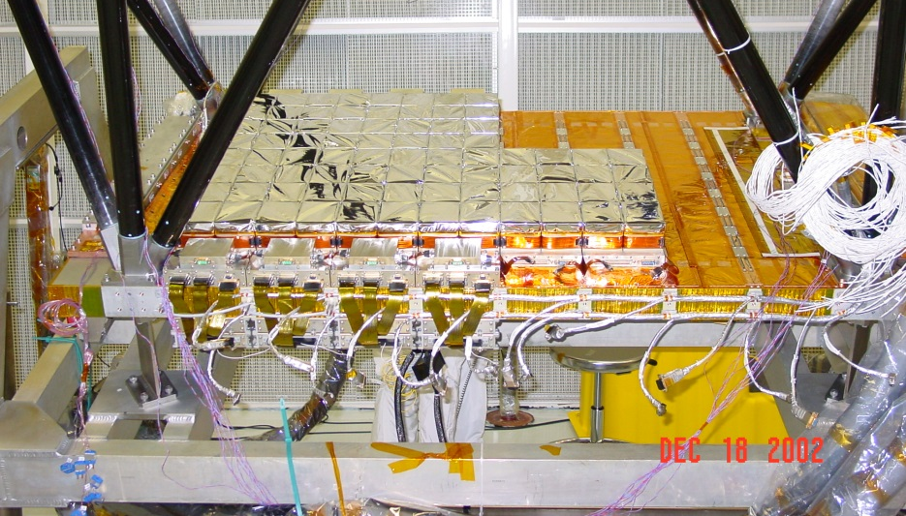
Burst Alert Telescope
X-rays blocked by the lead tiles create a “shadow” on the detectors

Slide 40
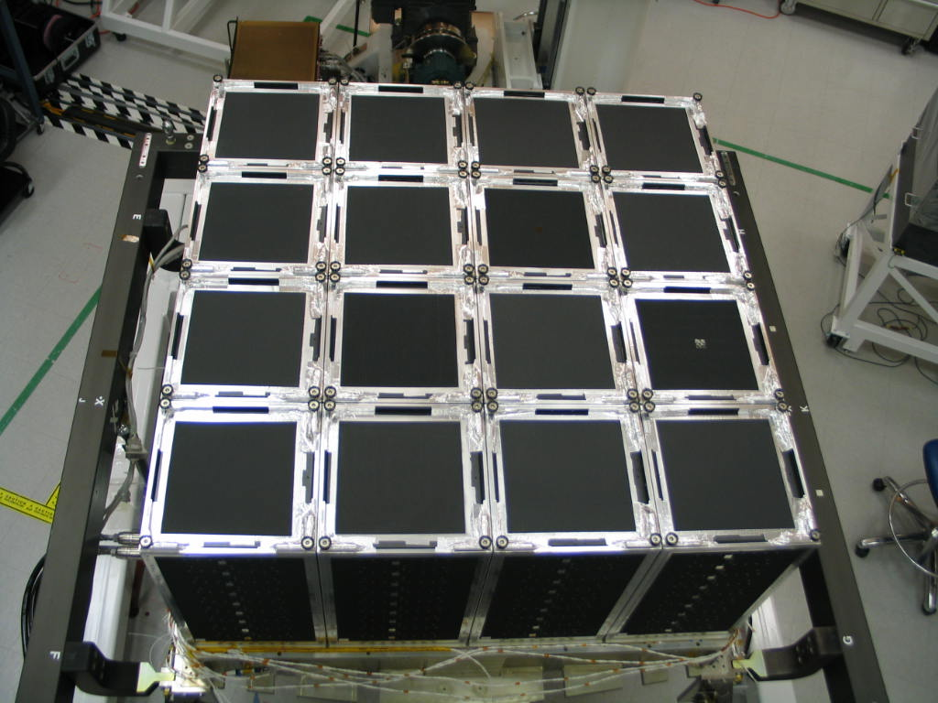
How to detect gamma rays?
Can’t image or focus gamma rays
Special detectors: scintillating crystals, silicon-strips
This is Fermi’s Large Area Telescope
It is a pair-conversion telescope with a calorimeter

Slide 41

Pair-annihilation
E = mc²
m = mass of the electron or positron
E = energy of gamma ray
Anti-matter partners of e- are positrons (e+)
When they meet, they annihilate each other!
13

Slide 42
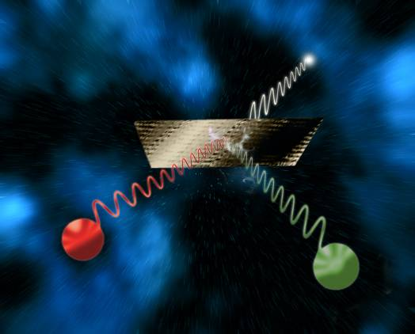
Now in reverse….
This process is called “pair conversion” as the incoming gamma-ray converts into an electron/positron pair
γ
tungsten
14

Slide 43
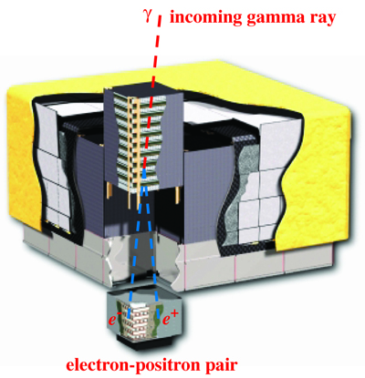
How the LAT works
Anticoincidence Detectors – screen out charged particles
Tungsten converts gamma rays into e+ e- pairs
Calorimeter measures total energy

Slide 44
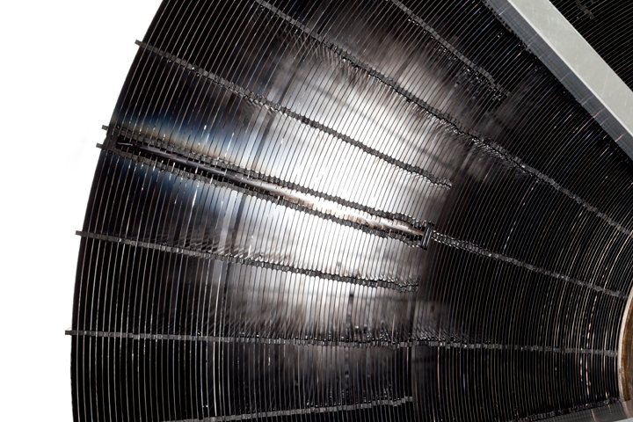
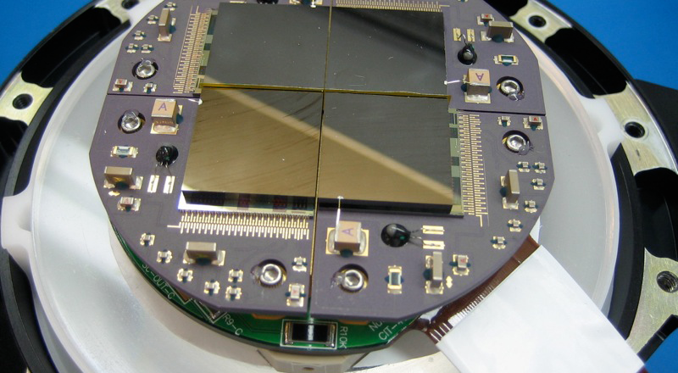
NuSTAR’s mirrors and detectors
133 nested mirrors made of multilayers that reflect higher-energy X-rays
A 2 x 2 array of Cd-Zn-Te detectors and electronics

Slide 45
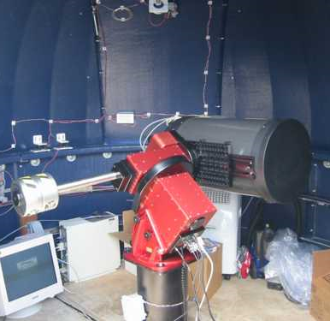
Global Telescope Network
Students do ground-based visible-light observations using remote telescopes
GRBs and flaring blazars
Coordinated with Fermi and other satellite data
http://gtn.sonoma.edu
GORT at Pepperwood

Slide 46
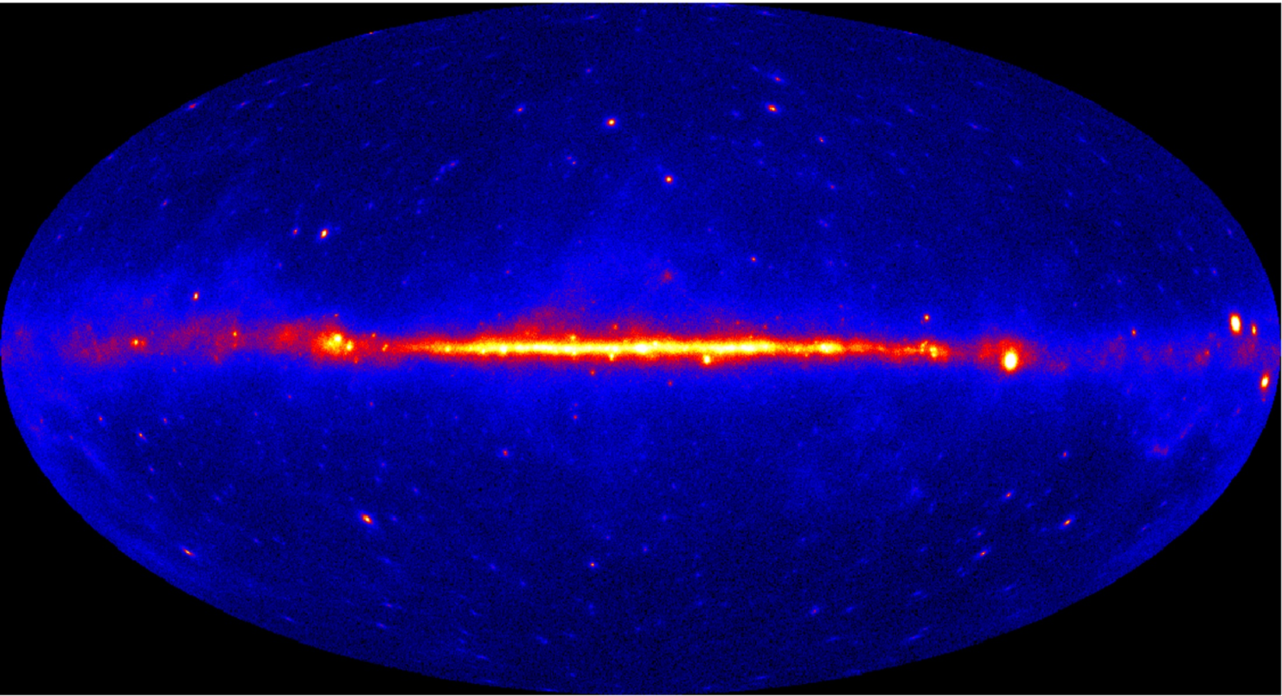
Fermi skymap – new discoveries
Bright blazar
Gamma-ray pulsar
Unidentified
High-mass binary
Cosmic rays from SN W44
Radio galaxy
Globular cluster

Slide 47
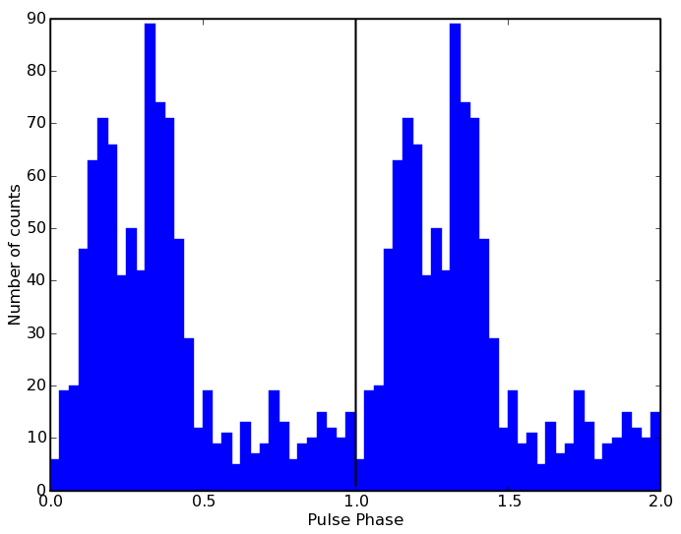
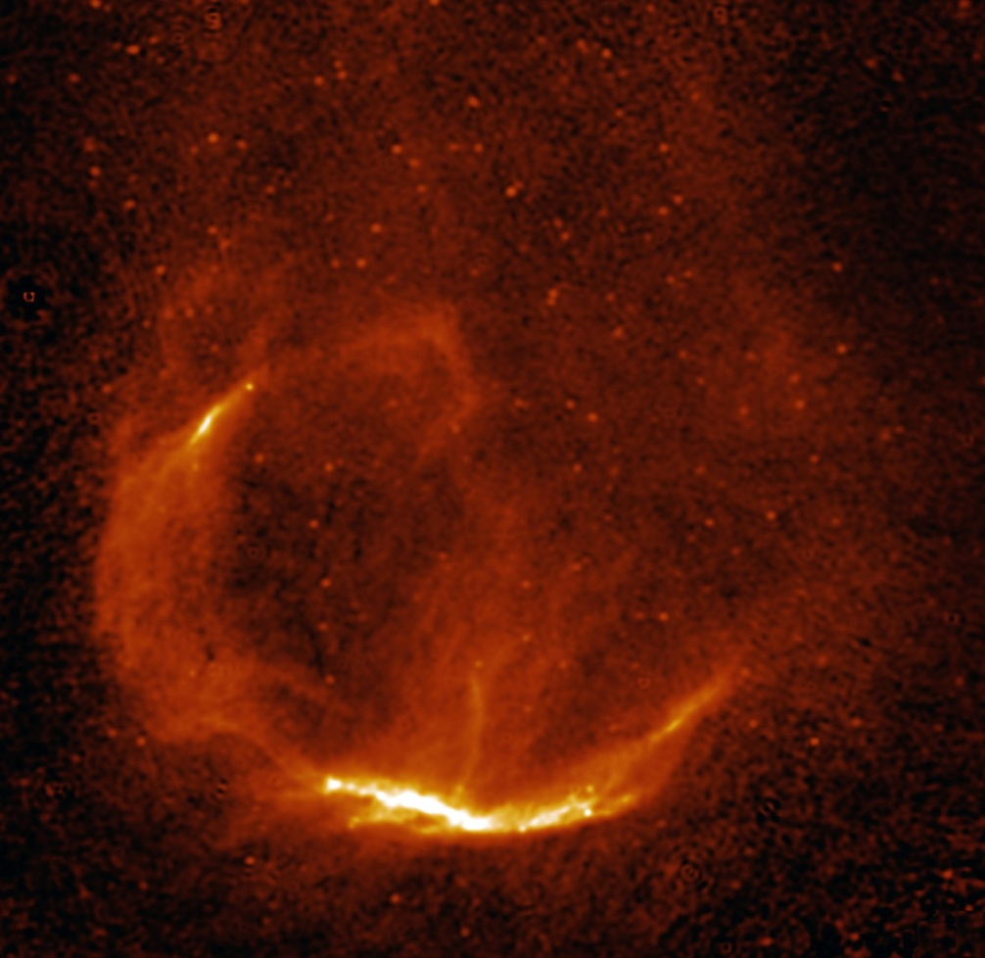
Fermi finds 1st gamma-ray only pulsar in CTA1
P = 315.86 ms
age ~1.4 x 10⁴ yr
3EG J0010 +7309 95% error box
Pulsar is not at center of SNR
It’s moving at 450 km/sec – kicked by the supernova explosion that created it
RX J00070+7302
+
Fermi 95% error box
47
CTA 1 supernova remnant

Slide 48
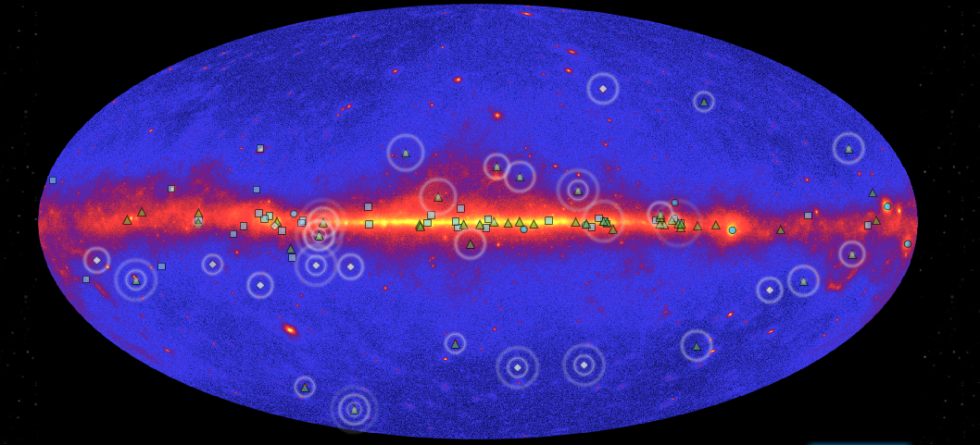
Pulsar Explorer interactive
http://www.nasa.gov/externalflash/fermipulsar/

Slide 49
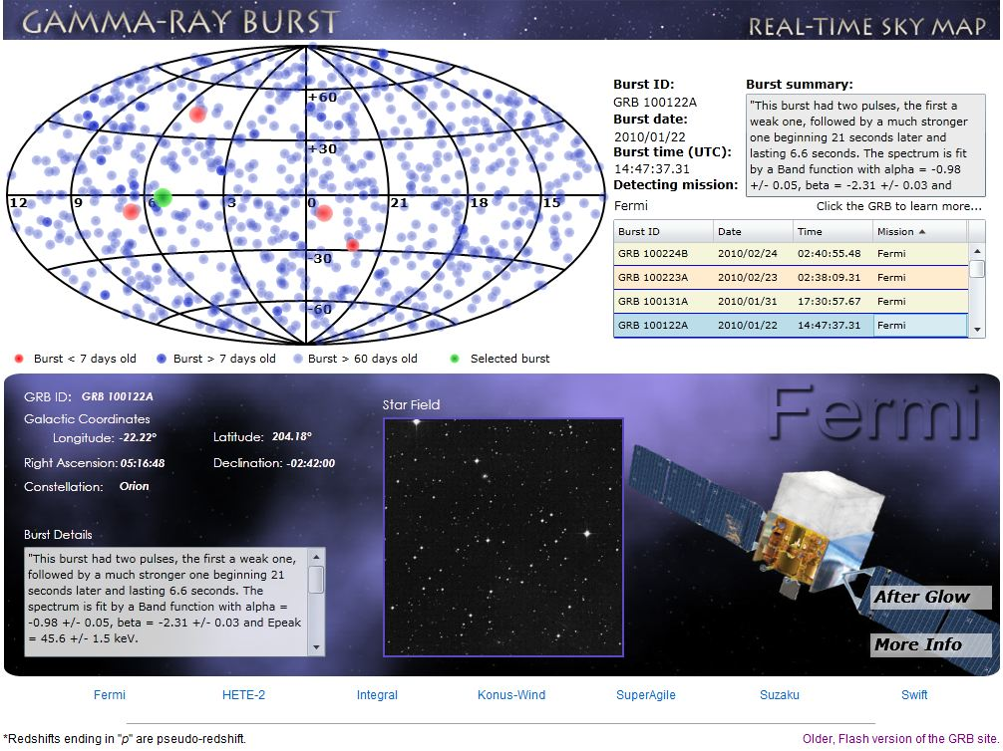
Follow GRBs every day

Slide 50
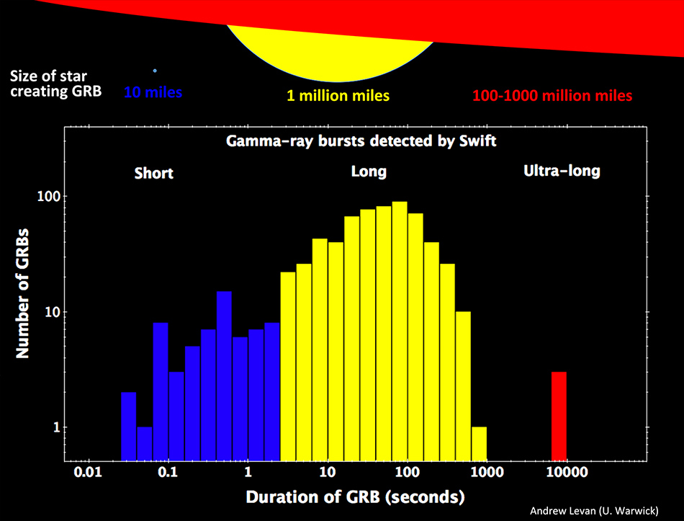
April news – ultralong bursts

Slide 51

Blue supergiant system
Credit: CNRS/Céline Lavalade

Slide 52

Types of bursts

Slide 53
Using GRBs to test Special Relativity
Short GRBs can be used to test Einstein’s claim that light travels at a constant speed
Some theories of quantum gravity predict that higher-energy photons will interact with the “quantum foam” of space-time and will travel slower than low-energy photons

Slide 54

Will quantum foam entangle photons?
Fermi sees no evidence for this to date
Two photons which differed in energy by 10⁶ arrived at Earth within 1 second, after traveling for 12.2 billion years

Slide 55
⁴⁴Ti Imaging Cas A
67.8 +/- 1.2 keV
67.8 +/- 1.2 keV
8-10 keV
Fe band

Slide 56

NuSTAR timing of Cyg X-1
Cyg X-1 is a stellar mass black hole in a binary system that is accreting matter from a supergiant companion star
NuSTAR saw it in the soft state
Notes:
The breakthrough with this observation wasn’t isolating the emission from the rest of the galaxy, but the very low background afforded by focusing
This high energy sensitivity is what is enabled us to break the degeneracy between different models for broad band emission, and therefore unambiguously measure the spin of this SMBH

Slide 57

Detailed look at Cas A Continuum
4.5-6 keV
15-20 keV
Hard Rims
8-10 keV
20-25 keV
10-15 keV
25-35 keV
Bright knots
Soft interior

Slide 58


Gamma-ray Burst Monitor (GBM)
All sky coverage
12 sodium iodide scintillators
  10 keV to 1 MeV
  Burst triggers and locations
2 bismuth germanate detectors
  150 keV to 30 MeV
  Overlap with LAT
http://gammaray.msfc.nasa.gov/gbm/

Slide 59

NuSTAR and Black Hole Spin

Slide 60

Measuring black hole spin
NuSTAR measures the high energy X-rays which help to differentiate these models
General Relativity predicts line shapes for spinning black holes
Different spin directions produce different shapes

Slide 61
NuSTAR measures NGC 1365
NuSTAR’s measurements revealed the BH spin rate is >84% of maximum

